Slide 1
Presenter Name and Degree Here
Your organization here
Date of presentation
Name of meeting

Slide 2


To be confident, be prepared
Make sure you understand each questionnaire very well and that you can use it easily and correctly.
Review questionnaires until you feel confident and comfortable with them.
Fumbling can cause the respondent
to lose confidence in you.
Make sure you have all materials
with you before heading to the field.
Notes:
Being prepared is a crucial part of fieldwork. To be prepared, you should make sure you understand each questionnaire very well and that you can use it easily and correctly.
Review each questionnaire until you feel confident, comfortable, and able to administer it to a respondent. Being prepared can help you avoid fumbling, which can cause respondents to lose confidence in you.
Make sure you have all materials (questionnaires, maps, writing implements, descriptions of areas or venues you will visit) with you before heading to the field.

Slide 3
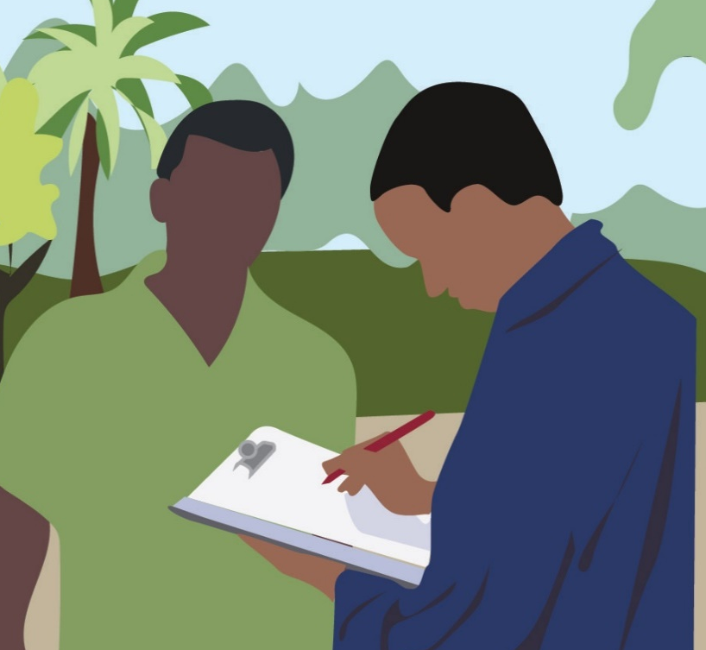
Establish good rapport and stay neutral (1)
A successful interview is founded on a good relationship with the respondent.
Show that you are an understanding and friendly person.
Avoid seeming bored, uninterested, or hostile.

Slide 4




Establish good rapport and stay neutral (2)
Do not allow your words, tone of voice, or body language to convey judgment.
Remain friendly but neutral; avoid acting surprised, critical, approving, or disapproving.

Slide 5
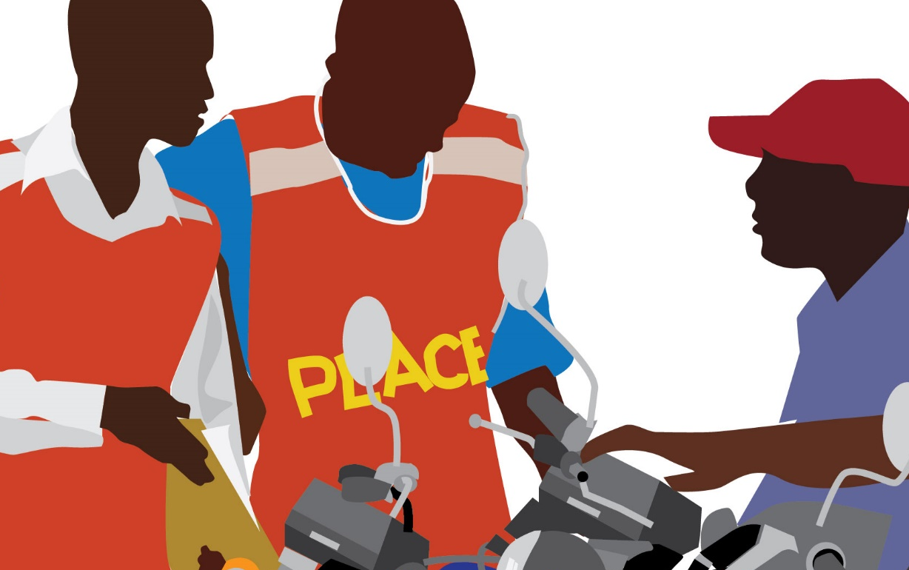
Be professional
Interviewers carry out fieldwork only for PLACE.
Do not combine with other causes or activities such as canvassing for political or religious organizations.

Slide 6

Asking the questions
Ask the questions in order.
Read the questions as they appear on the form. The words on the questionnaire have been selected carefully.
  Only rephrase the question if the
  respondent does not understand it.
  Do not rephrase questions in a way
  that suggests answers.

Slide 7
Asking the questions
Avoid showing the questionnaire to the respondent
  Respondents may be influenced by knowing what questions are coming next or by seeing answer categories
Conduct the interview in privacy
  If others are observing, respondents may change the way they answer.

Slide 8
Why is all this important?
Good rapport, a nonjudgmental attitude, and interviewing in privacy are the best ways to obtain honest and accurate responses.
Reading questions as written and in order help ensure consistency among respondents
High-quality information

Slide 9

Art of probing (1)
Probing serves three main functions...
  To encourage the person being interviewed to give more information, be clearer, or finish up an answer
  To discourage the person being interviewed from giving irrelevant information
  To improve rapport by indicating that you (the interviewer) are paying attention

Slide 10
Art of probing (2)
When else should you use a probe?
  If a respondent has trouble putting his/her thoughts into words
  If a respondent hesitates to give you certain information
Notes:
Other times a probe comes in handy are when a respondent has trouble putting his/her thoughts into words, and when a respondent hesitates to give you certain information.
This presentation will cover several examples of probing techniques.

Slide 11
Art of probing (3)
Probes you can use:
  Repeat the question you just asked.
  Repeat what the person being interviewed said last.
  Say, “Anything else?” for questions where more than one response is possible.
  Ask neutral questions such as,
  “What do you mean?”
  Use nonverbal cues (pause, look, or nod) to give the person time to gather his or her thoughts.
Notes:
There are many ways to probe. (Read slide).

Slide 12

“I don’t know” responses
People say “I don’t know” when they:
  Do not understand the question
  Feel uncomfortable answering
  Really don’t know the answer
Notes:
“I don’t know” is a common response. Respondents say “I don’t know” when they don’t understand a question, feel uncomfortable answering a question, or really don’t know the answer to a particular question.

Slide 13

What to do with “I don’t know” responses
Probing helps to avoid “don’t know” answers:
Repeat the question.
Sit quietly and wait.
Say, “Well, what do you think?” or “I just want your own ideas.”
Try to probe at least once.
Don’t force an answer;
stop right away if the respondent
becomes irritated or annoyed.
Notes:
Probing can also be used to gather more information when a respondent says, “I don’t know.” Probes after a respondent has said “I don’t know” include repeating the question, sitting quietly and waiting for the respondent to add more, or saying, “Well, what do you think – I just want your own ideas.” Try to probe at least once if a respondent answers, “I don’t know.”
If a respondent seems annoyed when you probe for further information after he or she has said, “I don’t know,” stop and go on to the next question. You don’t want to irritate the respondent.

Slide 14
Avoid leaving blanks
Participants have the right to refuse to answer a question.
However, they may not answer a question for the same reasons they may say “I don’t know.”
Try probing to eliminate leaving a response blank.
If there is a blank, the supervisor does not know if you skipped a question or if the respondent did not answer.

Slide 15
Controlling the interview
It is important to maintain control of the interview so it can be completed on time and in order.
If a respondent provides information that will be covered later in the interview, you can:
    Politely tell the respondent that you must ask other questions first
    Write down the information and confirm it at the appropriate stage of the interview
Notes:
While you want to be open and nonjudgmental toward the respondent, it is important that you do maintain control of the interview so it can be completed on time and in the order indicated by the questionnaire.
If a respondent provides information that will be covered later in the interview, you can either politely tell the respondent that you must ask other questions first or write down the information he or she has given you and confirm it later, at the appropriate stage of the interview.

Slide 16
Ending the interview
Tell the respondent that you are grateful for his or her very helpful cooperation.
Immediately check the questionnaire to make sure it is complete; if answers are skipped or are not clearly marked, follow up with the respondent right away.
Notes:
When the interview is over, be sure to express your appreciation to the respondent. Thank the respondent for his or her cooperation.
Immediately check the questionnaire to make sure it is complete; if answers are skipped or are not clearly marked, follow up with the respondent right away, while you are still able.

Slide 17
Be prepared and be polite
Reread the instructions or interviewer script often to refresh your memory!
Remember to practice and make sure you are comfortable with the questionnaires.
Carry the field supervisor’s phone number with you to the field in case questions arise. Ask!!!!!
Be polite to everyone you meet. Remember, you are representing everyone working on PLACE!

Slide 18

Write clearly
Be sure to record answers accurately and legibly.
Notes:
Also, be sure to record all information legibly. Make sure that another person can easily read what you have written or tell which response the respondent gave. If you must cross out a response, do so clearly so the reader knows which one should be used.

Slide 19


Take care of forms/tablets
Protect the paper questionnaires or tablets from dirt or damage.
Notes:
Take good care of the questionnaires; it takes a long time to collect data and you want to make sure they are readable and not damaged or soiled. When using a tablet or phone, be careful it does not get wet!

Slide 20
The importance of confidentiality
It is the responsibility of the interviewers to protect the confidentiality of the people involved in the study.
    Responses to questions
    Identity
Do not discuss the respondent or responses in public where you can be overheard.
Do not discuss the interviews with anyone outside the PLACE team.
Do not allow non-PLACE team members to see questionnaires.

Slide 21
Confidentiality pledge
All interviewers must pledge to keep information confidential.
There should be no tolerance of breaches in confidentiality.
Respondents are sharing details about their community and about their own lives. Be respectful!
Notes:
Note: Give an Interviewer Confidentiality Pledge form to each interviewer to sign. There’s one in the Fieldwork Implementation Guide and also a discrete file in the PLACE Tool Kit, online.

Slide 22
Safety risks during fieldwork
Some interviews will take place in the evening or at night.
Some selected areas may be dangerous.
You are likely to encounter drunk people or people who use drugs when visiting venues at night.
Notes:
PLACE carries with it some potential risks to interviewers who will be walking around communities, sometimes at night. It is important to voice any concerns you have to supervisors. Some risks include: READ SLIDE.

Slide 23
Staying safe during fieldwork
Always stay within sight of another interviewer.
Always tell another interviewer or supervisor where you are going next.
Only enter a venue in pairs, never alone.
Carry phone numbers for all team members.
Carry identification and an authorization letter.
Immediately leave a dangerous environment and contact the Fieldwork Supervisor.
Fill out an incident report form if there is a problem.
Notes:
Note: Adapt to local needs. If interviewers will not carry an authorization letter, delete that from the slide. If there is no incident report form, delete that from the slide. If there are other plans for safety, include them in this list.
READ SLIDE
Communicate to the supervisor if you feel unsafe. Conditions may change during a day of field work. You may begin the day feeling safe, but later things become less so. Call the supervisor to tell them about the change and leave the situation immediately.

